Slide 1

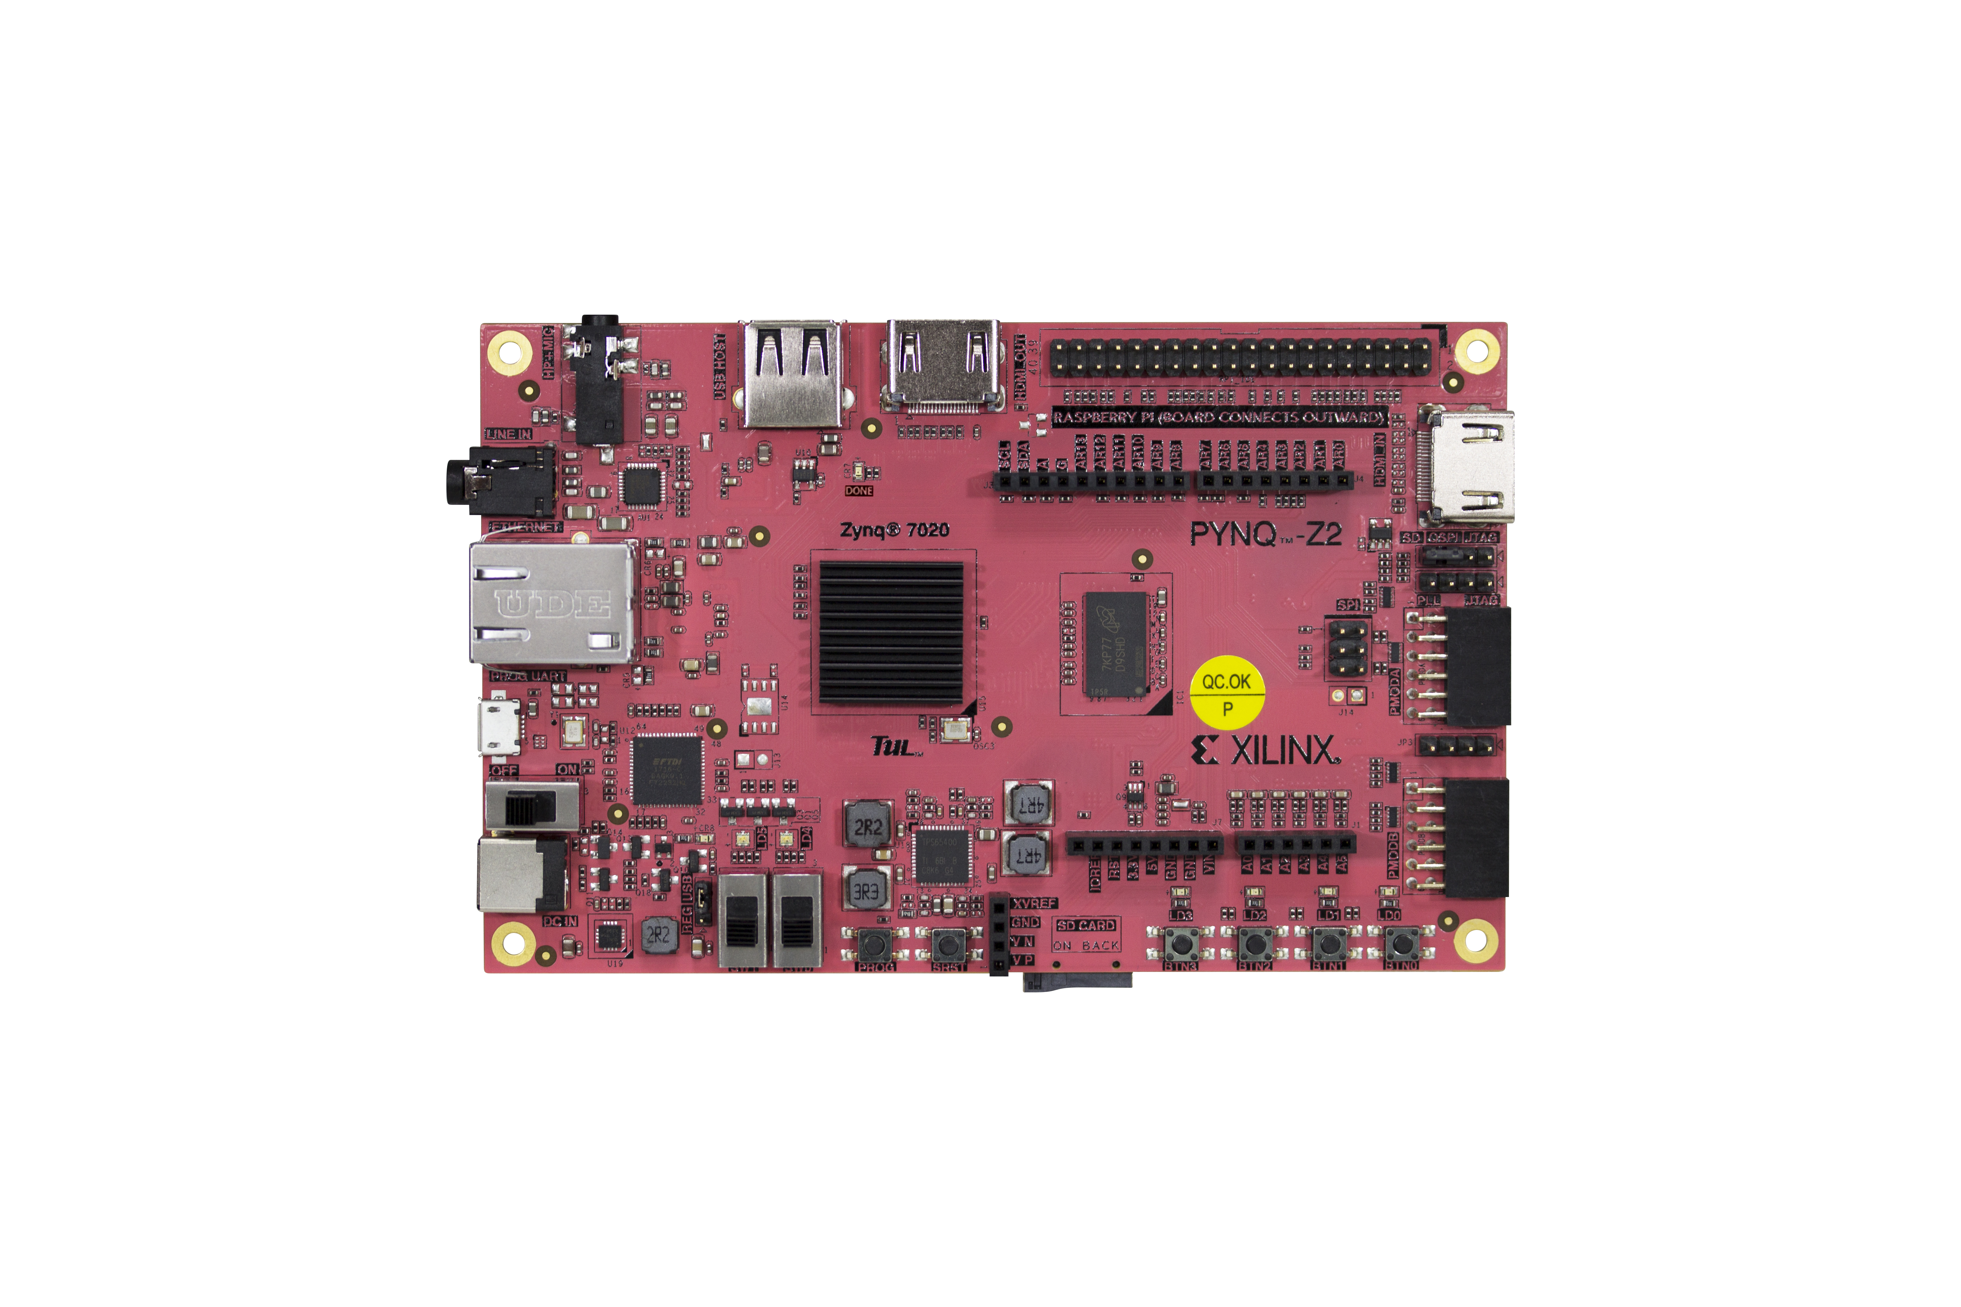
CRYPTOGRAPHYv
[ DEPT. OF ELECTRONICS & COMMUNICATION ]
A FLEXIBLE FPGA APPROACH TO IMAGE
CRYPTOGRAPHY
Using PYNQ-Z2 — Xilinx Zynq-7000
REF.NO.
Lagineni Sreenithai · Raghavendra S M · Chandrakiran S M · Mulukuri Vallesh Nath
22_EC_19
Guide: Ms. Chaithra S

Slide 2

SECTION
PROBLEM & SOLUTION
01 / 12
THE PROBLEM
OUR APPROACH
Explosive data growth
AES-128 on FPGA Fabric
Medical scans, biometrics, surveillance, and satellite imagery traverse open networks continuously.
Hardware-accelerated encryption via Vivado HLS, controlled through a Python software interface.
The Case for Hardware Encryption
CPU bottleneck
Software AES/RSA on CPUs introduces high latency unusable for real-time telemedicine and live monitoring.
HARDWARE
SOFTWARE
FPGA Speed
Python Jupyter
Software AES on CPU cannot meet real-time multimedia demands.
BRIDGE
TARGET
Security threats
AXI DMA
Low Latency
Unauthorized access, data breaches, and malicious tampering are growing in severity.
Dept. of Electronics and Communication— K.R. PURAM, BENGALURU

Slide 3
SECTION
HARDWARE PLATFORM
02 / 12
PROCESSING SYSTEM PS
PROGRAMMABLE LOGIC — PL
ARM Cortex-A9
FPGA Fabric
Image acquisition via Python
HLS Encryption IP core (Vivado)
Pixel packing to 128-bit AES blocks
Pipelined AES-128 hardware modules
Image reconstruction post-decrypt
DMA burst transfers (256–4096 bytes)
[ PYNQ-Z2 / ZYNQ-7000 ]
AXI-LITE
AXI-STREAM
AXI-DMA
PS control signals: start/stop, key, IV
High-speed pixel stream PS ↔ PL
Bulk image transfer from DDR to fabric
PYNQ-Z2 Board
ARM CORTEX-A9
Dual-core Processing System
FPGA FABRIC
Programmable Logic for HLS
ETHERNET / USB-UART
Network transfer & debug
MICRO SD
Linux boot image storage
Dept. of Electronics and Communication— K.R. PURAM, BENGALURU

Slide 4
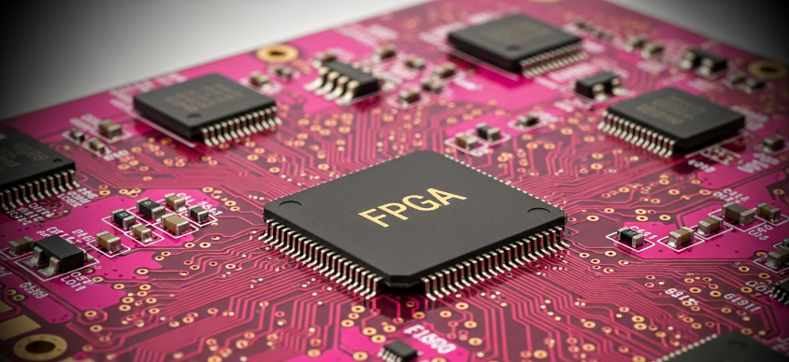
SECTION
AES-128 ENGINE
03 / 12
ROUND 0
→
ROUNDS 1–9
→
ROUND 10
AddRoundKey
Sub + Shift + Mix + AddKey
Sub + Shift + AddKey
STEP 01
STEP 02
STEP 03
STEP 04
SubBytes
ShiftRows
MixColumns
AddRoundKey
Non-linear S-box substitution — confusion
Cyclic row shifting — inter-byte diffusion
Galois Field GF(2^8) matrix multiply
XOR with round-derived key — key mixing
BLOCK SIZE
KEY LENGTH
TOTAL ROUNDS
CIPHER TYPE
128-bit
128-bit
10
Symmetric
FPGA Advantage
Each round stage maps to a pipelined hardware module — parallel execution, minimal latency per block.
Dept. of Electronics and Communication— K.R. PURAM, BENGALURU

Slide 5
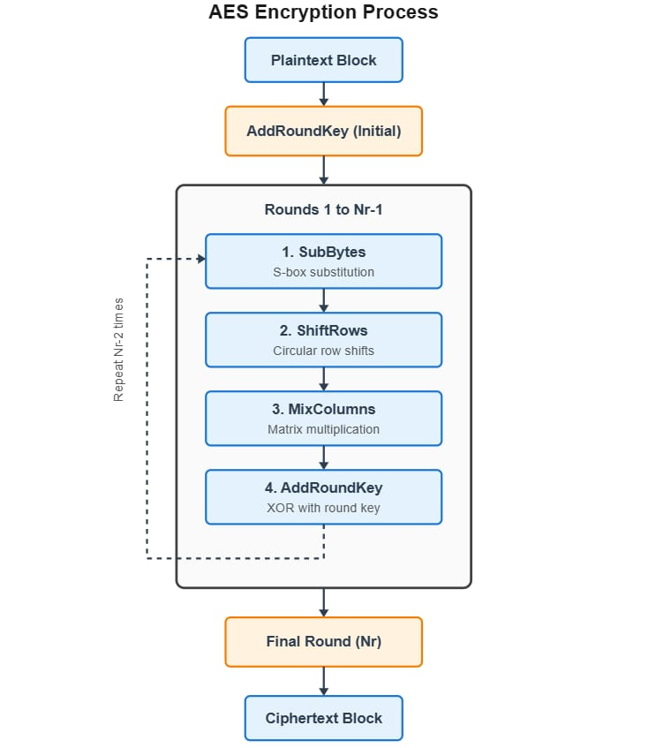
SECTION
AES-128 ENCRYPTION PROCESS
04 / 12
Dept. of Electronics and Communication— K.R. PURAM, BENGALURU

Slide 6
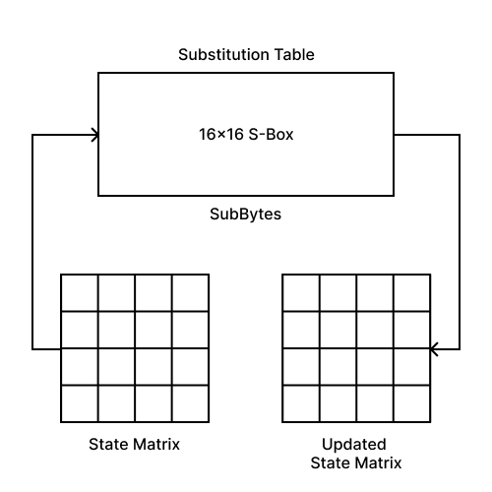
SECTION
AES-128 ENCRYPTION
05 / 12
SUB BYTES
SubBytes is a non-linear byte substitution step where each byte of the 4×4 state matrix is replaced using a fixed AES S-Box, introducing cryptographic confusion.
This operation is designed to resist linear and differential cryptanalysis by breaking simple mathematical relationships between plaintext and ciphertext.
Dept. of Electronics and Communication— K.R. PURAM, BENGALURU

Slide 7
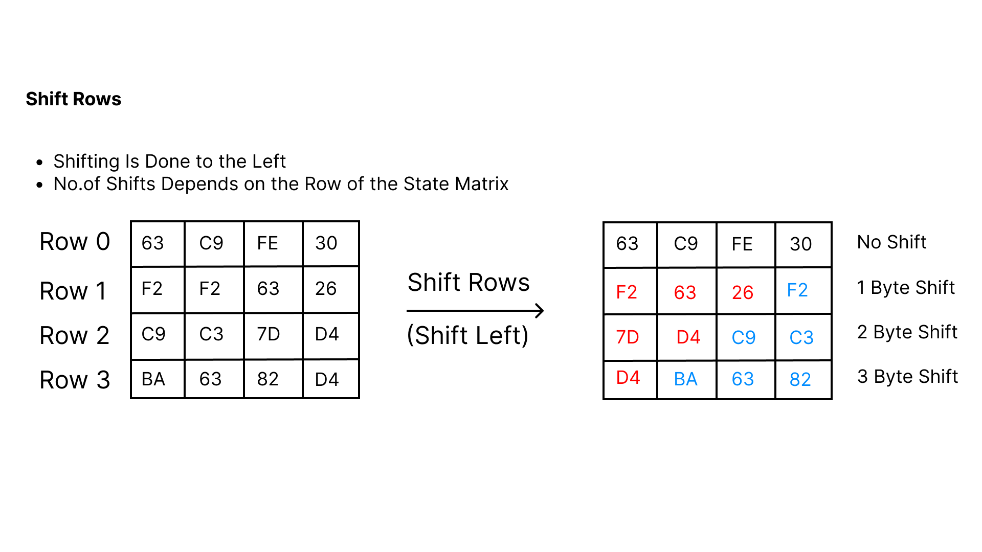
SECTION
AES-128 ENCRYPTION
06 / 12
SHIFT ROWS
Dept. of Electronics and Communication— K.R. PURAM, BENGALURU

Slide 8
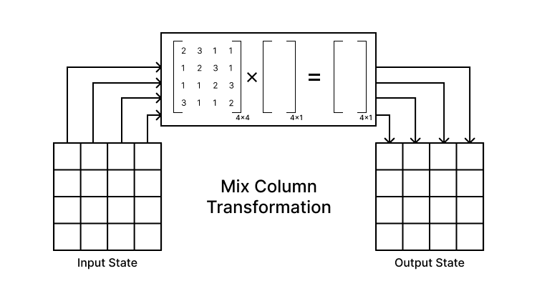
SECTION
AES-128 ENCRYPTION
08 / 12
MIX COLUMNS
MixColumns treats each column of the state matrix as a polynomial and multiplies it with a fixed constant Matrix.
This operation ensures strong diffusion, meaning a single input byte affects multiple output bytes across the column.
Dept. of Electronics and Communication— K.R. PURAM, BENGALURU

Slide 9
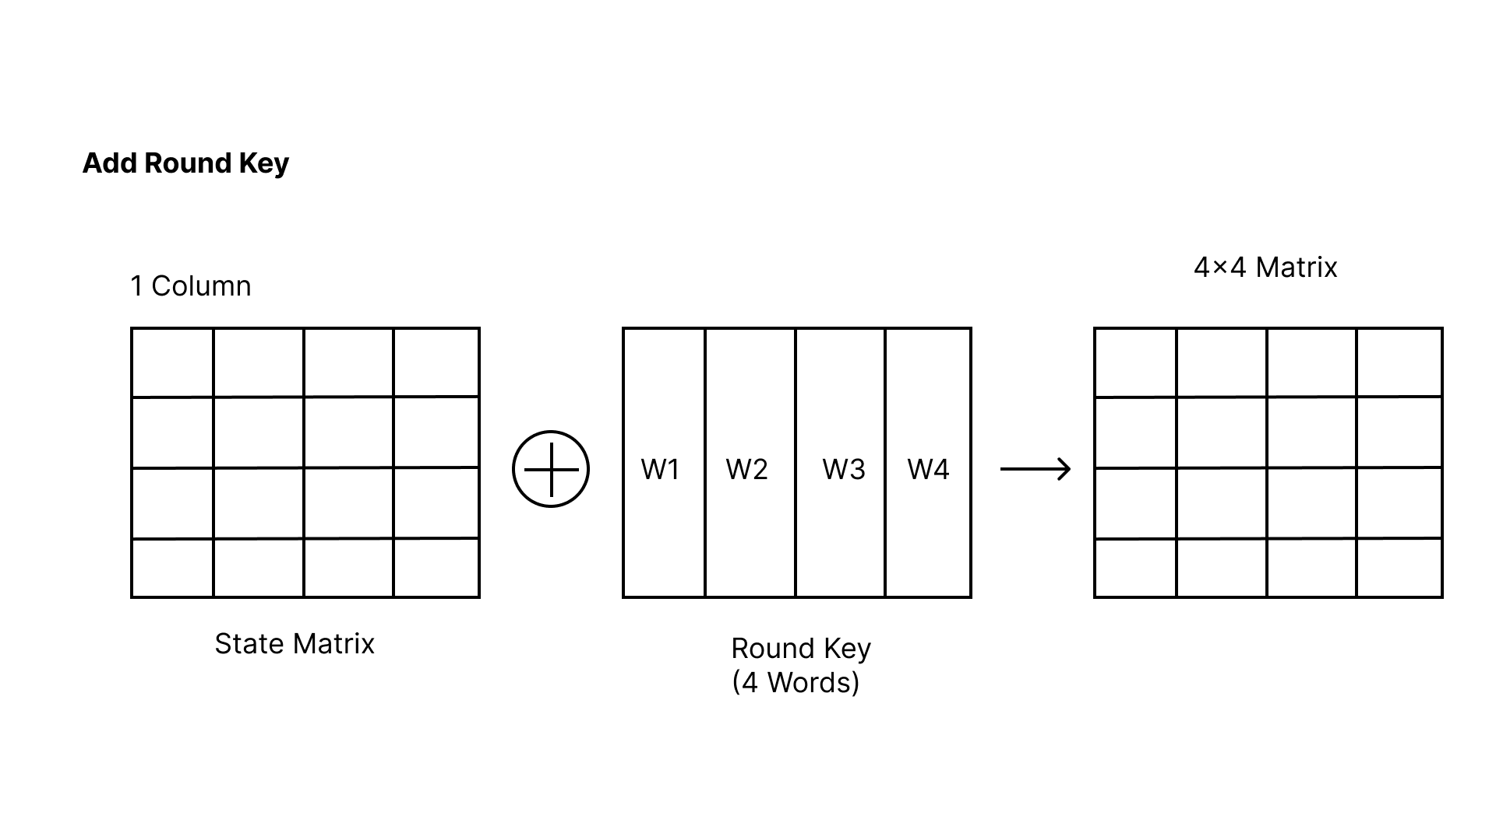
SECTION
AES-128 ENCRYPTION
09 / 12
ADD ROUND KEY
AddRoundKey combines the current state matrix with the round key using a bitwise XOR operation, directly injecting key material into the data.
Since XOR is reversible, this step ensures secure key mixing while allowing correct decryption using the same round key.
Dept. of Electronics and Communication— K.R. PURAM, BENGALURU

Slide 10

SECTION
VERIFICATION & RESULTS
10 / 12
FUNCTIONAL VERIFICATION
TIMING SUMMARY
Encrypted output
METRIC
VALUE
Visually indistinguishable from random noise
WNS
0.523 ns
TNS
0.000 ns
Decrypted image
WHS
0.016 ns
Perfect lossless restoration — pixel-exact match
Failing Endpoints
0 / 41,536
Total On-Chip Power
2.784 W
ALL TIMING MET
Zero failing endpoints out of 41,536
WNS: 0.523 ns — all user-specified constraints satisfied.
Dept. of Electronics and Communication— K.R. PURAM, BENGALURU

Slide 11
SECTION
CONCLUSION
11 / 12
DEMONSTRATED
CO-DESIGN
Real-time AES-128 image encryption on PYNQ-Z2 FPGA
PS handles control logic; PL handles raw cryptographic computation clean separation of concerns.
0
128
2.784W
57.1°C
Failing endpoints
bit AES key & block
Total on-chip power
Junction temp (safe)
Future Directions
Optimize DMA burst behavior and reduce PS load.
Apply HLS/PL-level clock gating for power reduction.
Scale with additional parallel IP cores or multi-channel DMA.
Lagineni Sreenithai · Raghavendra S M · Chandrakiran S M · Mulukuri Vallesh Nath
Guide: Ms. Chaithra S | Department of Electronics & Communication Engineering

Slide 12
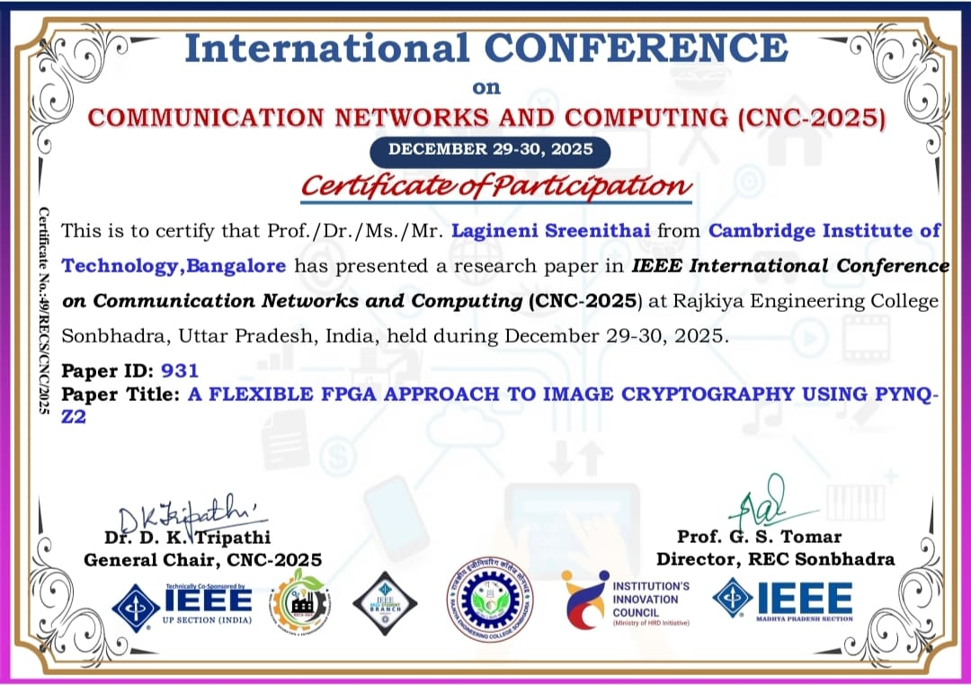
SECTION
CONFERENCE SUBMISSION
12 / 12
Lagineni Sreenithai · Raghavendra S M · Chandrakiran S M · Mulukuri Vallesh Nath
Guide: Ms. Chaithra S | Department of Electronics & Communication Engineering

